Slide 1


Upgrade your WinForms and WPF applications
with .NET Core, Windows 10, XAML Islands, MSIX and App Center
Olia Gavrysh @oliagavrysh
Russell Conard @Nature_Numbers

Slide 2
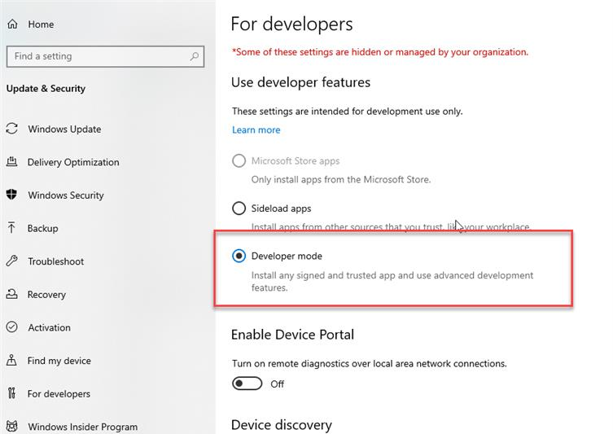
Technical Requirements
Windows 10 1903 (build 18362)
Visual Studio 2019 with the following workloads:
.NET desktop development
Universal Windows Platform development
.NET Core 3.0 SDK
Turn on Developer mode
in Windows settings:
Notes:
You need Windows 10 1903 (build 18362) SDK that comes with UPF workload

Slide 3
Today you will learn
Porting to .NET Core 3.0
Upgrading your apps with XAML Islands
Adding Windows 10 features to your apps
Packaging and deploying your application with MSIX
Creating a CI/CD pipeline with Azure DevOps
Integrating your desktop app with App Center

Slide 4

Porting to .NET Core 3.0

Slide 5
Agenda
Guided lab
Enhancing your own apps & Q&A

Slide 6





.NET Core 3
New development is happening in .NET Core, including runtime optimizations and new language features
.NET Core 3 is a platform for building anything
Some benefits of .NET Core 3:
Side-by-side versions
Self-contained app deployment
Core runtime and API improvements
Performance improvements
SDK-based .csproj project system
…and more
WEB
CLOUD
DESKTOP
IoT
AI
.NET Core 3

Slide 7
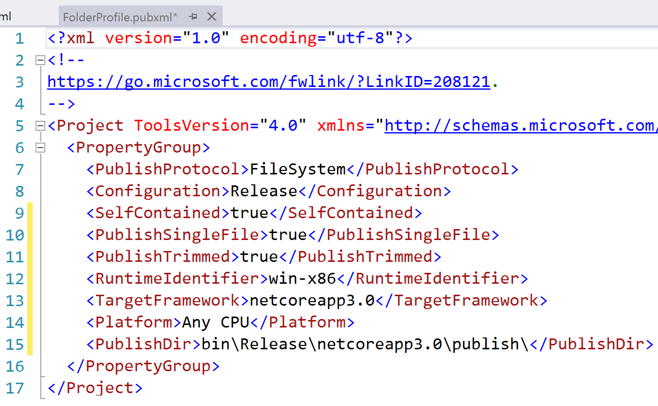
Single file smaller size .exe

Slide 8
Runtime Performance Impact
Runtime optimizations will be most noticed in:
File I/O
Networking
Database operations
For .NET Core 3.0, you may not see performance benefits in:
UI rendering performance
Startup time

Slide 9

Porting
What can possibly go wrong?

Slide 10
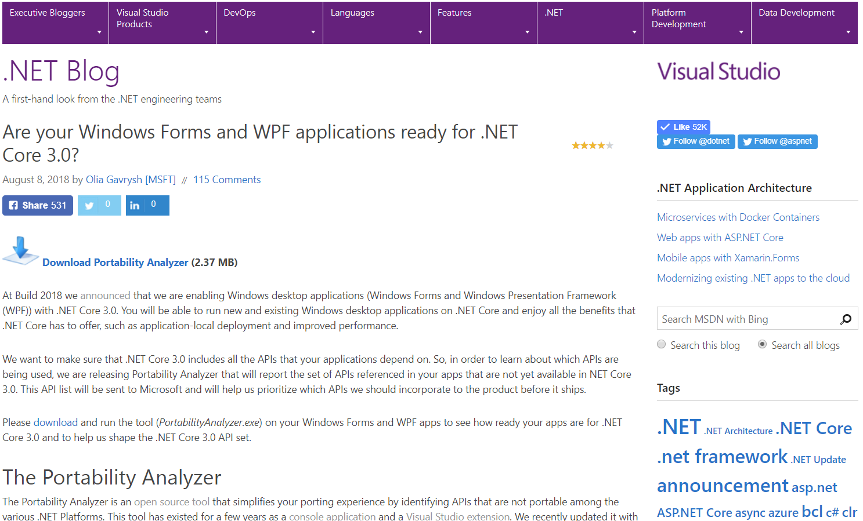
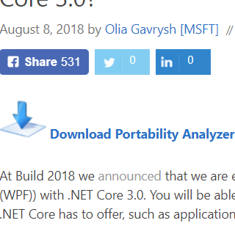
Is my application compatible with .NET Core 3?
Use Portability Analyzer
https://aka.ms/portabilityAnalyzer

Slide 11
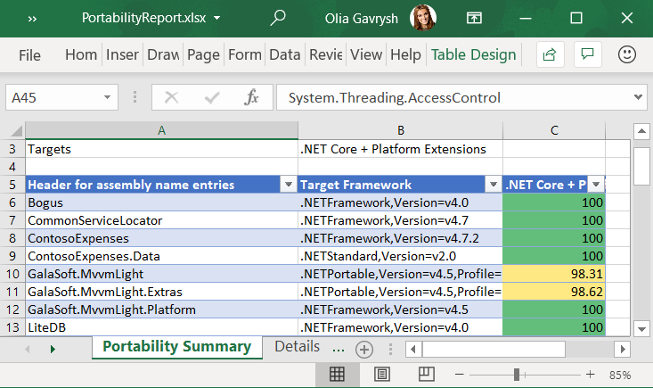
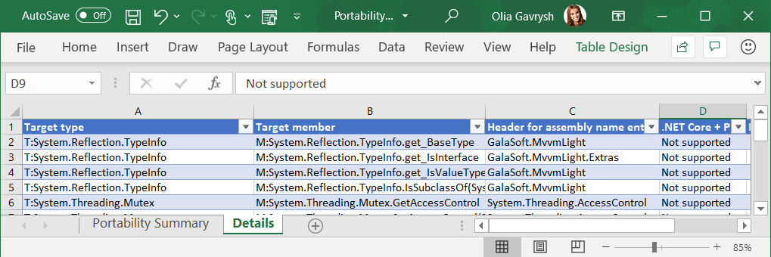
Portability Report

Slide 12
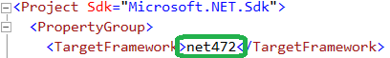
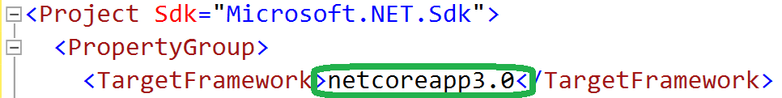
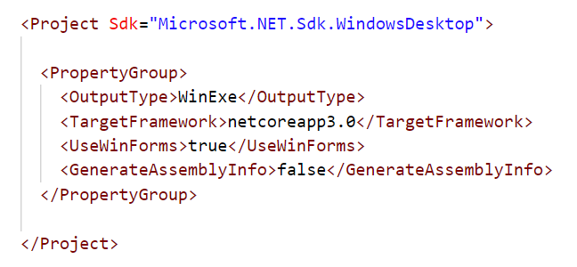
Porting
Porting to .NET Core\Standard is done by updating
If your .csproj file has old style, first migrate it to the new SDK-style

Slide 13
Porting tool
Try Convert
https://github.com/dotnet/try-convert
Will try to convert your old-style project file to the new SDK-style and retarget applicable projects to .NET Core 3

Slide 14
Fixing Porting Issues
Add NuGet packages for missing dlls
Windows Compatibility Pack
NuGet package Microsoft.Windows.Compatibility
Has ~21k APIs
Supports .NET Core & .NET Standard
WinForms Chart Controls
NuGet package System.Windows.Forms.DataVisualization

Slide 15
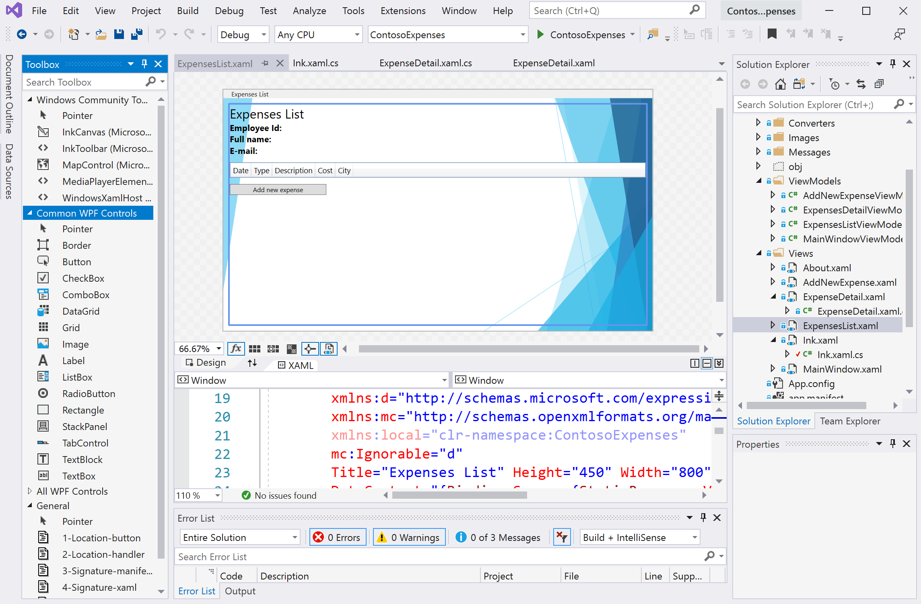

WPF Designer
Available in
Visual Studio

Slide 16

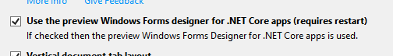
WinForms Designer Preview
Available in
Visual Studio 16.4 Preview 3
and later.
Check the checkbox in
Tools -> Options -> Environment -> Preview Features
Common controls and base operations
New updates with every VS Preview
Too early to port if you use designer a lot
Give us your feedback via Visual Studio feedback channel!

Slide 17
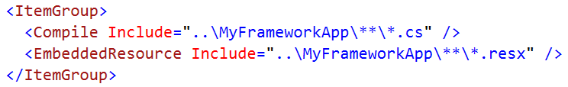
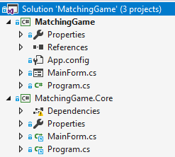
Option 1
Link existing .NET Framework sources into the new .NET Core app
Now you can use the designers in the old project while compiling it for .NET Core
.NET Core project links to files of .NET Framework project

Slide 18
Option 2
Have two project files: one targeting .NET Framework and another targeting .NET Core
Load your project with the Framework project file to work in WinForms designer

Slide 19

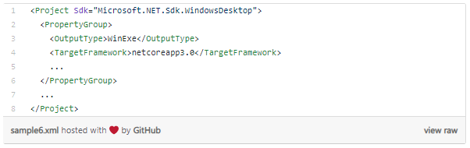
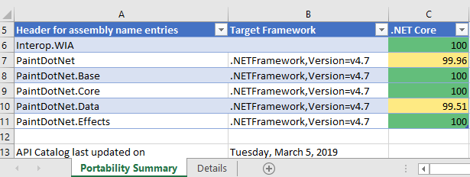
Step-by-Step Porting Guide
.NET Blog
https://aka.ms/porting-to-netcore3

Slide 20

Lab Exercise 1
Manual and source code: https://aka.ms/wamw

Slide 21
Upgrading your apps with XAML Islands

Slide 22
Platform options
WinForms
WPF
UWP

Slide 23

Platform options
WinForms
WPF
UWP

Slide 24
UI framework options
WinForms: https://github.com/dotnet/winforms
WPF: https://github.com/dotnet/wpf
WinUI: https://github.com/Microsoft/microsoft-ui-xaml

Slide 25
Modern UI and Input with XAML Islands
Windows Community Toolkit
Wrapped controls: Microsoft.Toolkit.Wpf.UI.Controls
InkCanvas
InkToolbar
MediaPlayerElement
MapControl
WebView (Windows 10 and Windows 7)
Host controls: Microsoft.Toolkit.Wpf.UI.XamlHost
Requires at minimum Windows 10 1903 (build 18362)
<!-- Windows 10 -->
<supportedOS Id="{8e0f7a12-bfb3-4fe8-b9a5-48fd50a15a9a}" />
<maxversiontested Id="10.0.18362.0"/>
Add to your manifest:

Slide 26
Lab Exercise 2 Exercise 3
Manual and source code: https://aka.ms/wamw

Slide 27
Adding Windows 10 features to your apps

Slide 28
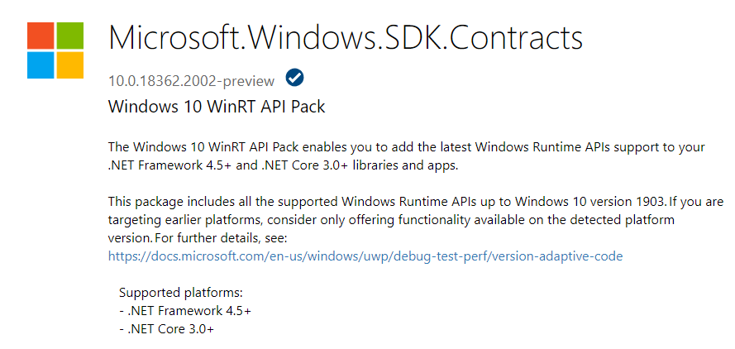
Easy Access to Platform and Device APIs
such as Bluetooth, Camera, Location, Notifications, etc…
NuGet package Microsoft.Windows.SDK.Contracts
includes all WinRT APIs up to Windows 10 version 1903
supports both .NET Core and .NET Framework
Notes:
Previously, in order to access the Windows API surface from your WPF or WinForms app, you needed to specifically add contract files and other reference assemblies to your project. Now you can simply add a NuGet package that will do the heavy lifting to add the contracts.

Slide 29
Lab Exercise 4
Manual and source code: https://aka.ms/wamw

Slide 30
Packaging and deploying your application with MSIX

Slide 31

MSIX
Your app is always up to date
Protects your data
Reusing your assets
Simplifies packaging, installation, update and uninstallation
Apps can work on any Windows 10 device
Clean uninstalls –
never regret installing an app again
https://github.com/Microsoft/msix-packaging
Notes:
MSIX is a new packaging model that is completely controlled by the operating system; it can be used to deploy applications not only using traditional approaches, like the web, SSCM, Intune, but it opens up now opportunities like the Microsoft Store / Store for Business / Store for Education; it helps developers to focus on building great application, leaving all the installation, update and uninstallation tasks to the operating system

Slide 32
Lab Exercise 5 Exercise 6
Manual and source code: https://aka.ms/wamw

Slide 33
Integrating your desktop app with App Center

Slide 34

App Center
Easily deploy your app
Collect app analytics to track usage patterns, user adoption, and other engagement metrics
See real-time diagnostics to discover and prioritize issues, bottlenecks, …
and many more…

Slide 35


Enhancing your apps Q&A
Olia Gavrysh
PM, .NET Team
@oliagavrysh
Russell Conard
PM, Visual Studio
@Nature_Numbers

